Slide 2
Useful resources
Karl Pearson F.R.S. (1901) LIII. On lines and planes of closest fit to systems of points in space, The London, Edinburgh, and Dublin Philosophical Magazine and Journal of Science, 2:11, 559-572, DOI: 10.1080/14786440109462720
Hotelling, H. (1933). Analysis of a complex of statistical variables into principal components. Journal of Educational Psychology, 24(6), 417–441. https://doi.org/10.1037/h0071325
Jolliffe, Ian T. and Cadima, Jorge (2016) Principal component analysis: a review and recent developments Phil. Trans. R. Soc. A.374 https://doi.org/10.1098/rsta.2015.0202

Slide 3
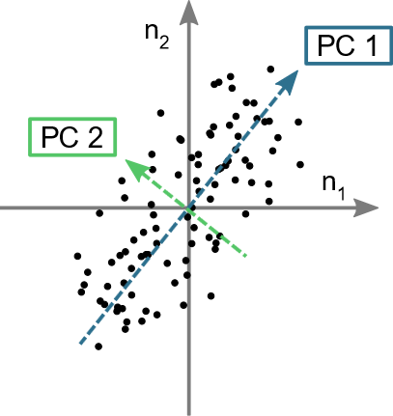
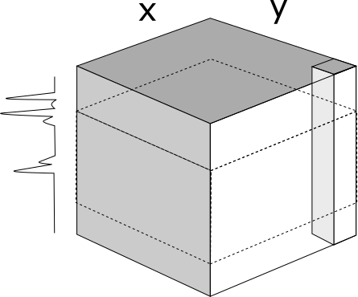

Principal component analysis
Aim: reduce a dataset with many variables by fewer variables that represent the majority of the key features
Seek correlation between measured variables
Aid visualisation and identify trends
p₂
Raman map
(n x p) array
p wavenumbers
p₁ | … | p_{j} | … | p_{J}
p₁
n spectra (n = xy)
p wavenumbers
PCA results do not account for position or surrounding spectra

Slide 4
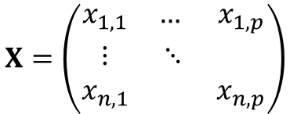

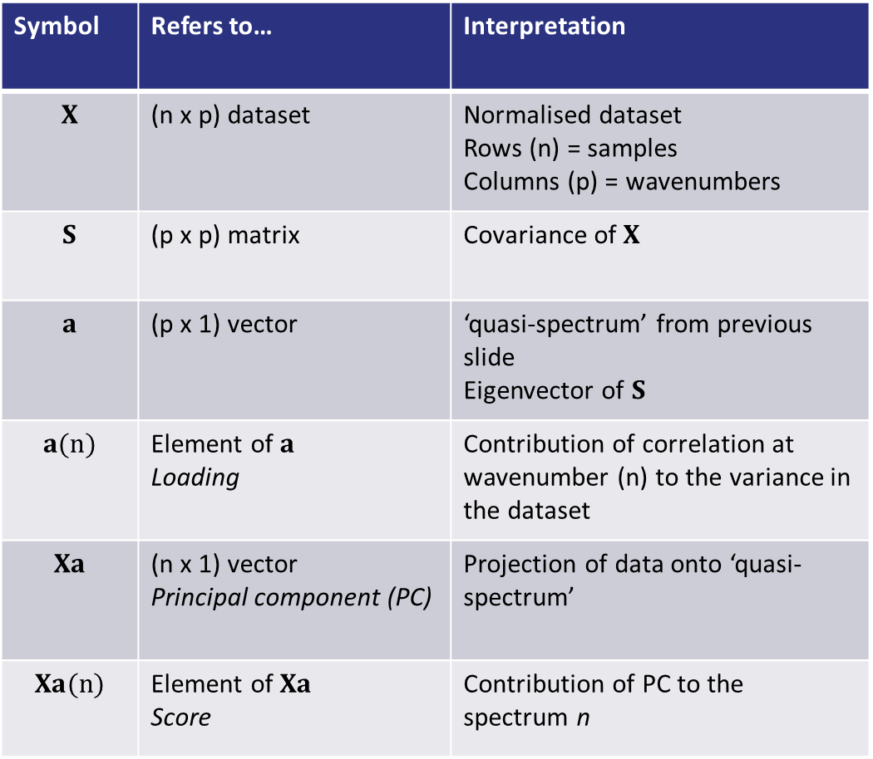
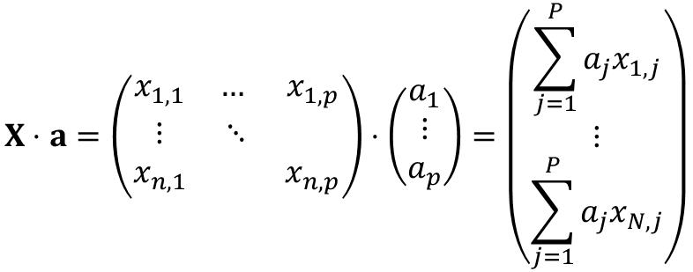

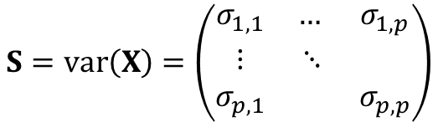
Principal component analysis: terminology reference
Symbol | Refers to… | Interpretation
$$X$$ | (n x p) dataset | Normalised dataset Rows (n) = samples Columns (p) = wavenumbers
$$S$$ | (p x p) matrix | Covariance of $X$
$$a$$ | (p x 1) vector | ‘quasi-spectrum’ from previous slide Eigenvector of $S$
$$a(n)$$ | Element of $a$ Loading | Contribution of correlation at wavenumber (n) to the variance in the dataset
$$Xa$$ | (n x 1) vector Principal component (PC) | Projection of data onto ‘quasi-spectrum’
$$Xa(n)$$ | Element of $Xa$ Score | Contribution of PC to the spectrum n
$$X=\left(\begin{matrix}x_{1, 1} & … & x_{1, p} \\ ⋮ & ⋱ & \\ x_{n, 1} & & x_{n, p}\end{matrix}\right)$$
$$S=var\left(X\right)=\left(\begin{matrix}σ_{1, 1} & … & σ_{1, p} \\ ⋮ & ⋱ & \\ σ_{p, 1} & & σ_{p, p}\end{matrix}\right)$$
$$Sa=λa$$
Principal component because ordered by eigenvalue, $λ$
$$X⋅a=\left(\begin{matrix}x_{1, 1} & … & x_{1, p} \\ ⋮ & ⋱ & \\ x_{n, 1} & & x_{n, p}\end{matrix}\right)⋅\left(\begin{matrix}a_{1} \\ ⋮ \\ a_{p}\end{matrix}\right)=\left(\begin{matrix}\sum_{j=1}^{P}{a_{j}x_{1, j}} \\ ⋮ \\ \sum_{j=1}^{P}{a_{j}x_{N, j}}\end{matrix}\right)$$

Slide 5
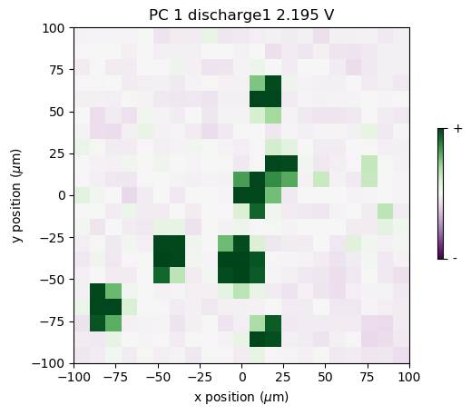
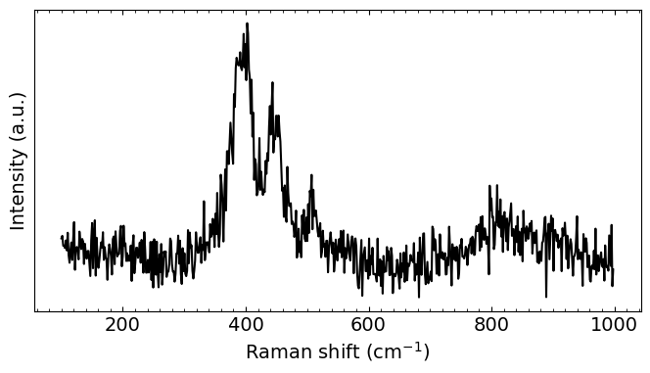
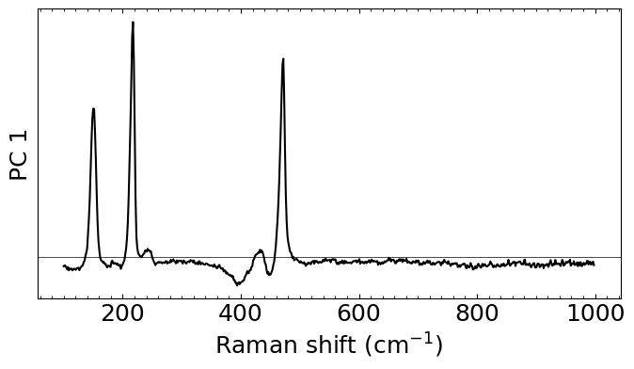
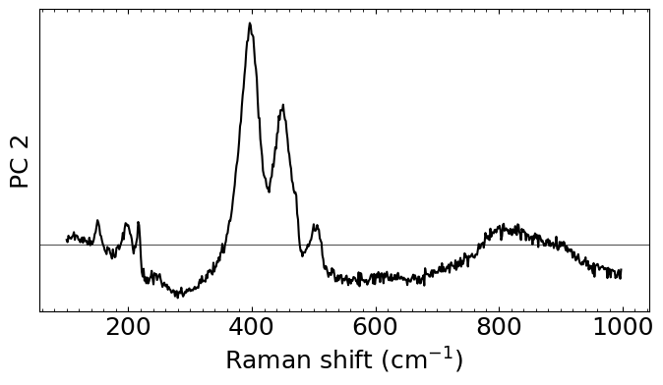
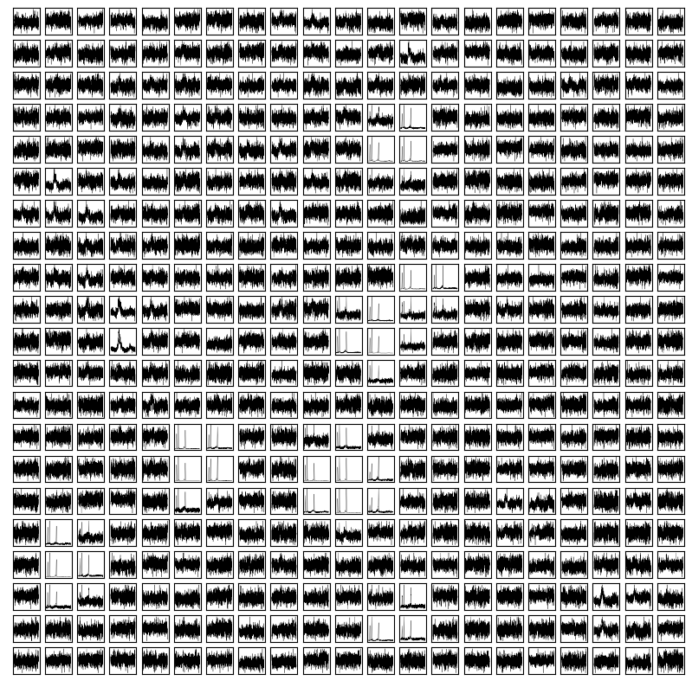
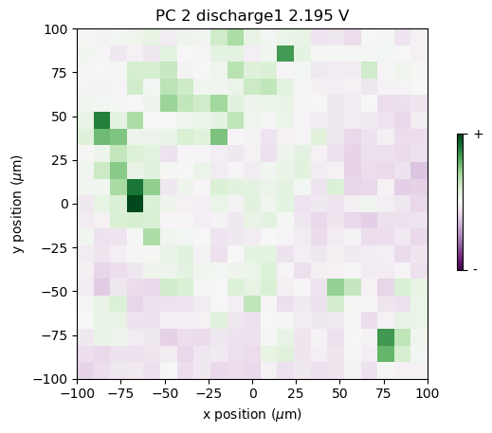
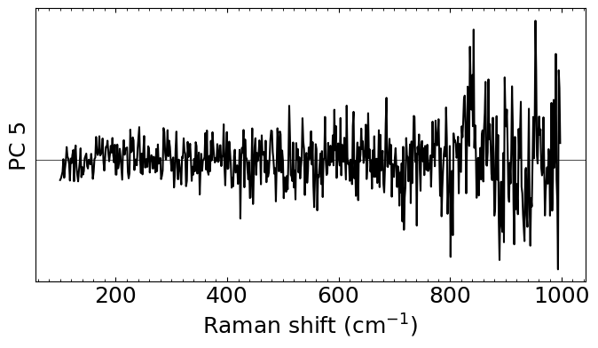




Principal component analysis
$${Xa}_{1}\left(x, y\right)×$$
$${Xa}_{2}\left(x, y\right)×$$
$$…$$
$$Xa_{N}\left(x, y\right)×$$

